Slide 1
Parkmeright
Mock-ups

Slide 2
Mock-up
Web Application

Slide 3
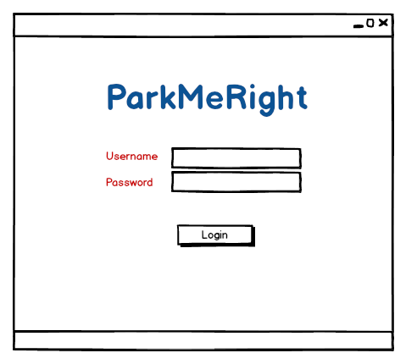
LOGIN PAGE
Notes:
The system operator would log in to account using his unique ID and password. On login, the operator would be directed to the form where he would have to fill in all the details and then continue further.

Slide 4
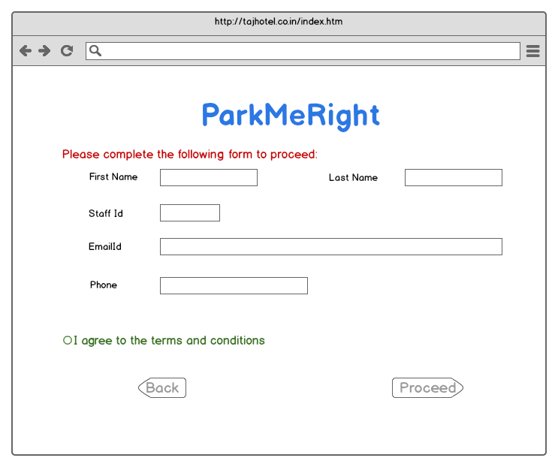
Staff’s Info Page
Notes:
The form includes the signup procedure for the staff in order to access an account on the system so that he can handle the parking process.

Slide 5
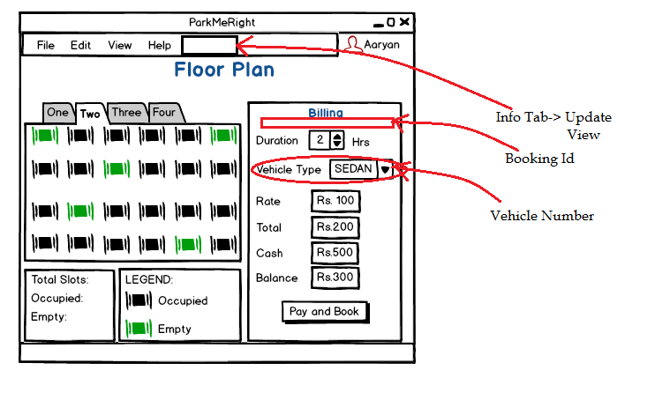
Parking Lot Booking Page
Notes:
This is how the account page of staff/operator would look like. There would be an option to update or modify the staff information whenever required.
On left hand side is the booking space where all the parking slots would be visible floor wise i.e. to see which all slots are occupied and which ones are free for booking.
On Right hand side is the billing process where the booking id, duration of parking and vehicle number are feeded to generate a bill. The payment can be made online(advanced feature) or at the time of exit.

Slide 6
ANDROID APPLICATION
MOCK-UP

Slide 7
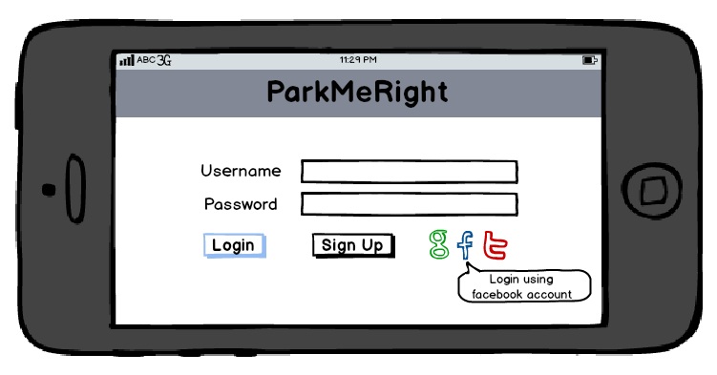
Login Activity
Notes:
The android user would first have to sign up in order to create an account to interact with the system. A user already having an account can log in in order to avail the facilities provided by ParkMeRight.
Advance feature:-
The user can log into his/her account using gmail/facebook or twitter account.

Slide 8
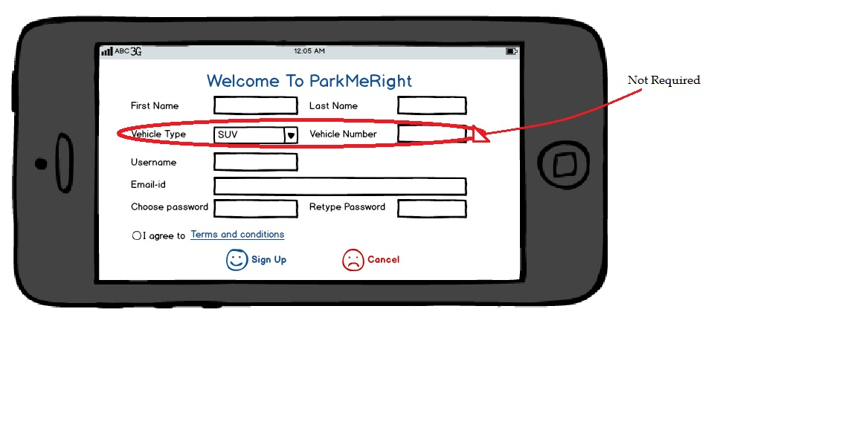
Registration Activity
Notes:
This is the sign up form. The user need not provide the vehicle type or number at the time of registration(Optional). Rest of the fields are mandatory. Once the user sign up, the account is created and they can avail the facilities of advance booking.

Slide 9
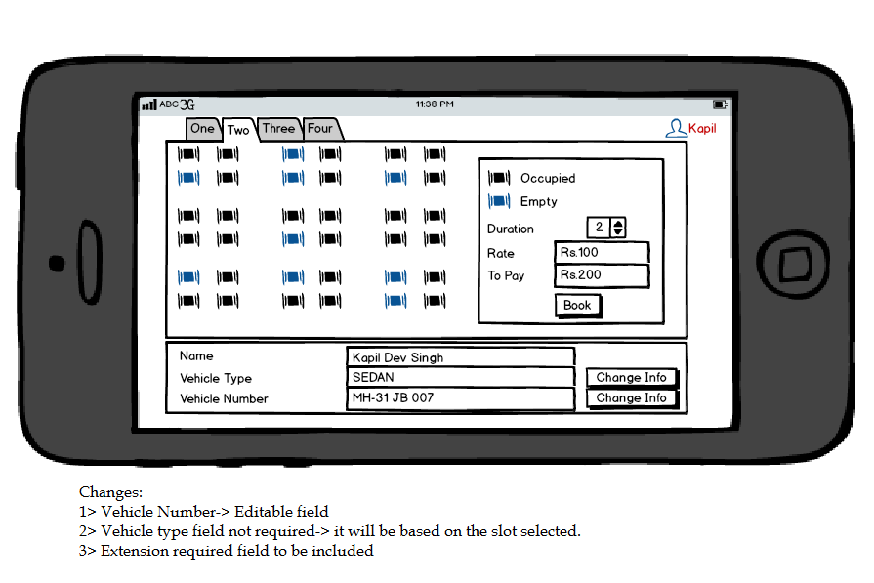
Slot Booking Activity
Notes:
This shows what all would be visible to the user when an account is logged in.
The floor wise booking status would be visible on left hand side so that they can choose an available free slot of their choice. They have to mention the duration for which the space is required by them. The rate would automatically be displayed as per the floor or slot selected.
The user info is displayed on the bottom and they can modify the information as and when needed. The vehicle type and number has to be provided in order to generate the bill at the system operator’s end.

